Slide 1

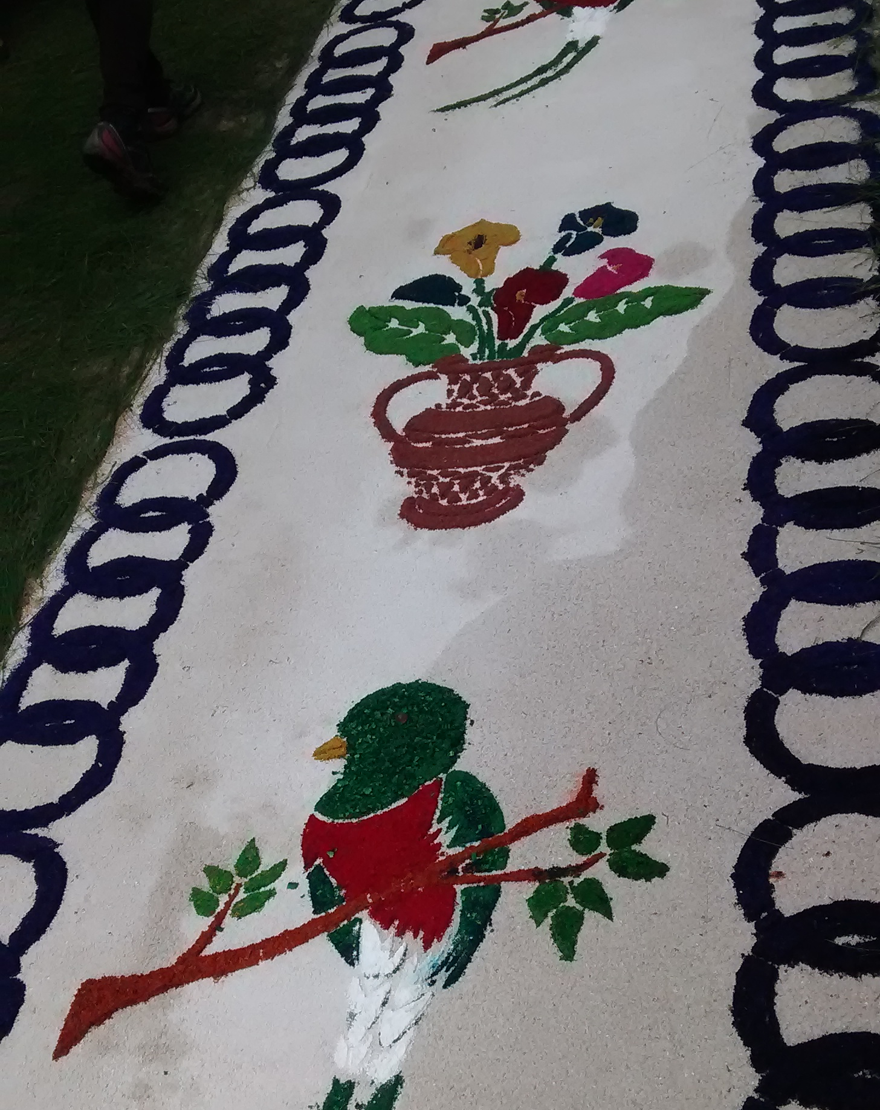
Pied piping in Kaqchikel Maya
Caleb Ewing, University of Florida
Fieldwork Forum, September 4, 2018

Slide 2
Pied piping in Kaqchikel Maya
Overview
Pied piping and pied piping with inversion
Prepositional phrases
Noun phrases
Quantifier phrases
Work on analysis

Slide 3
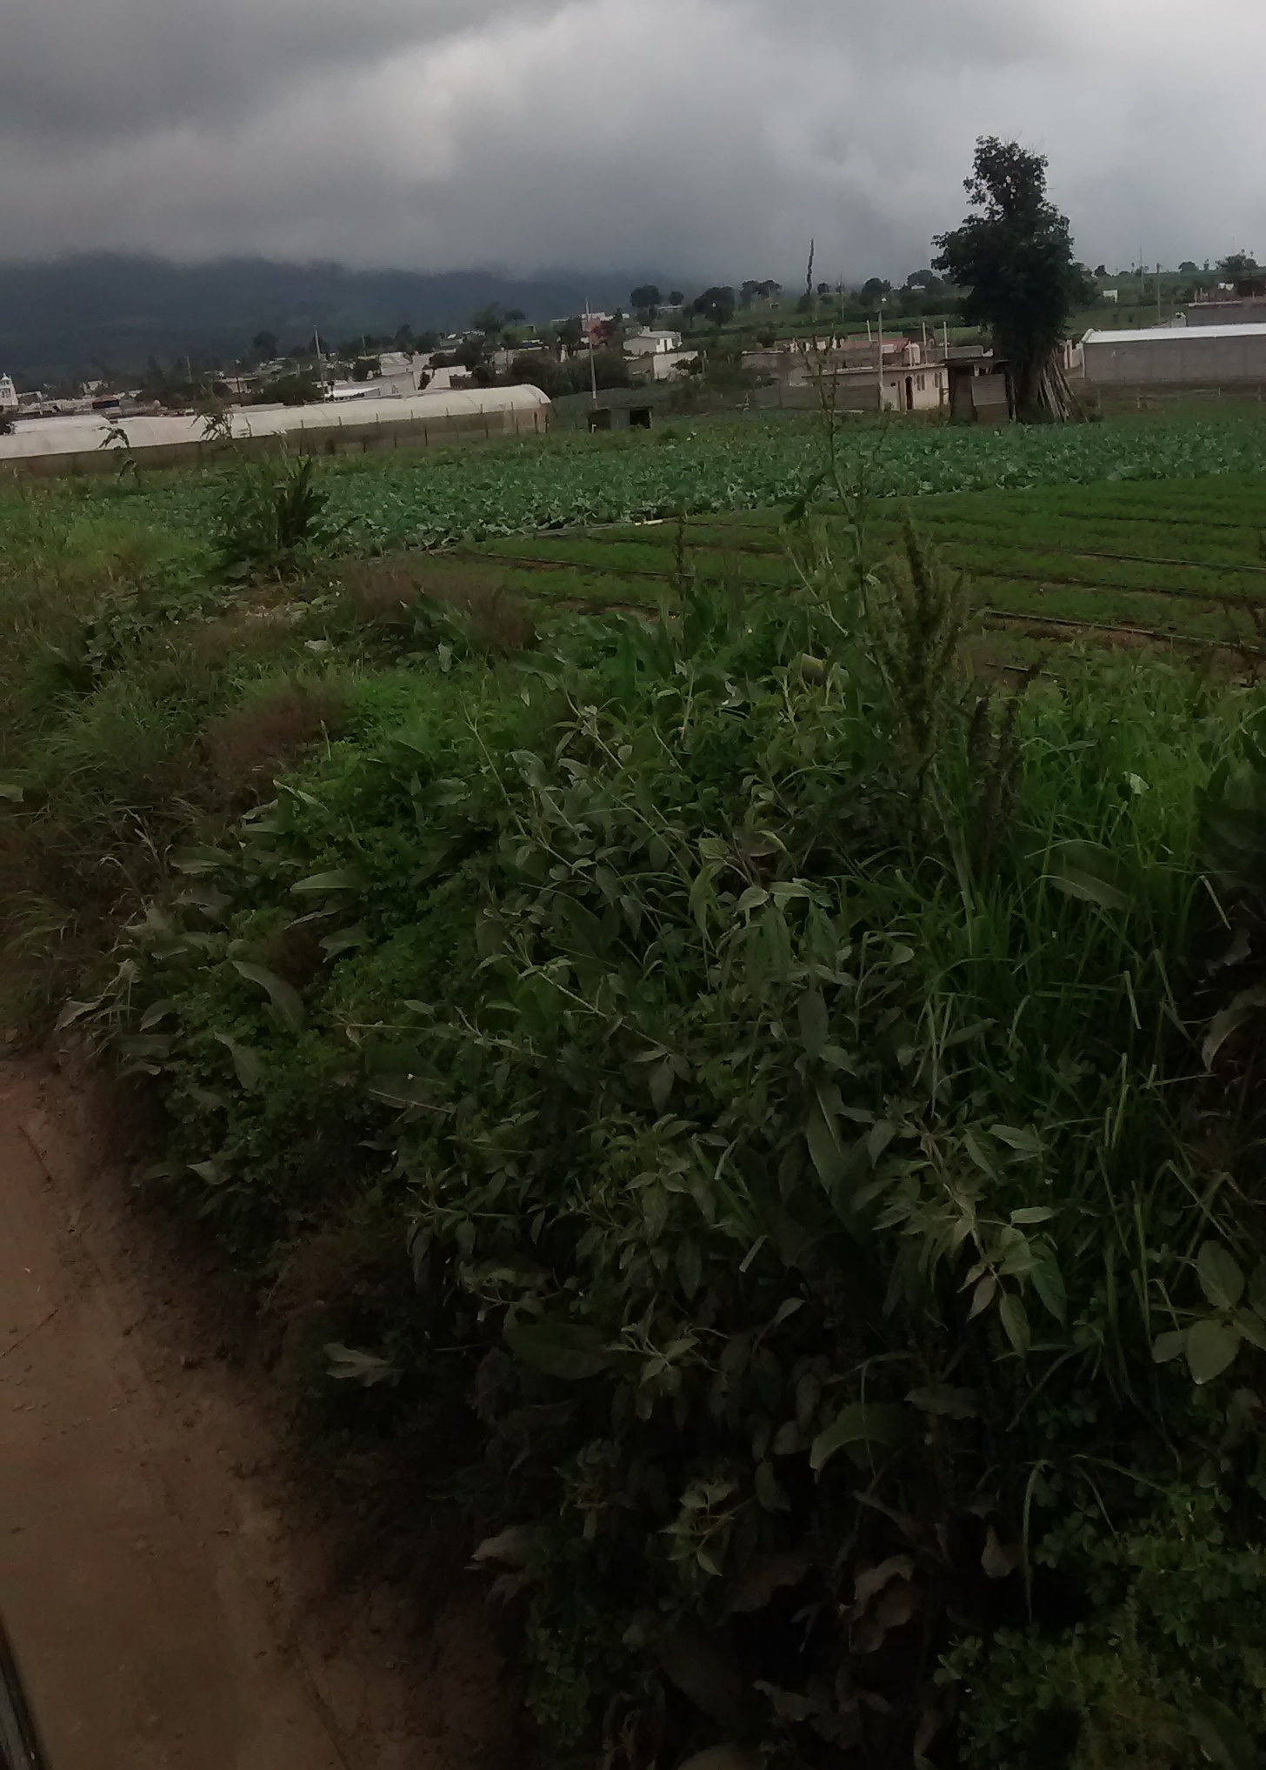
Overview
Kaqchikel is a Mayan language (Kichean branch) that is spoken in the Guatemalan highlands.
The fieldwork for this specific project was conducted this past June, 2018 in Patzún and Patzicía, Guatemala. I worked on the Patzicía dialect.
The research was mentored by the Guatemala Field School in Patzún, directed by Dr. Maria Polinsky and Dr. Pedro Mateo Pedro.

Slide 4
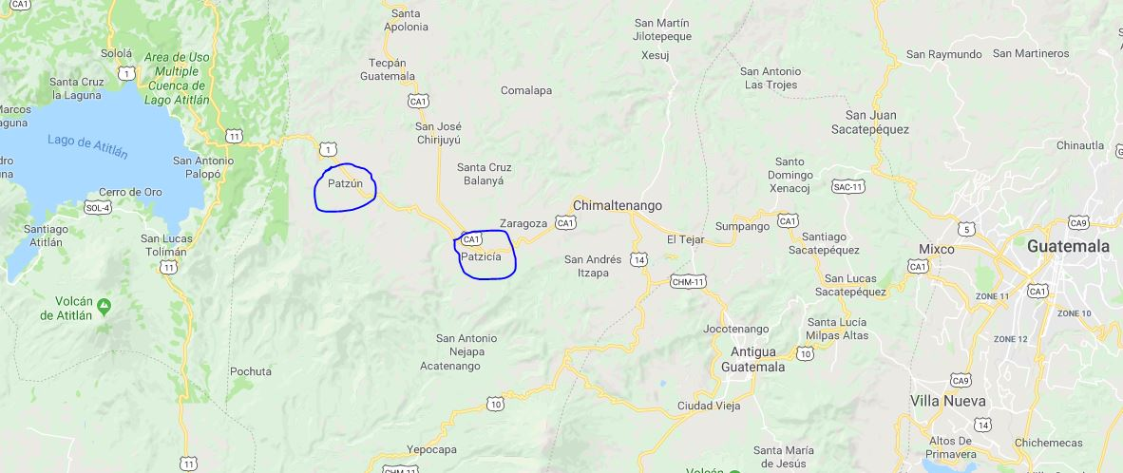
Overview
www.google.com/maps

Slide 5
Pied piping in Kaqchikel Maya
Overview
Pied piping and pied piping with inversion
Prepositional phrases
Noun phrases
Quantifier phrases
Work on analysis

Slide 6
Pied piping and pied piping with inversion
When the syntactic movement of some material causes other material to move with it, this is referred to as pied piping.
(1a) Which dog did you see?
(1b) *Which did you see dog?
The movement of the wh-word 'which' forces the noun 'dog' to move as well.

Slide 7
Pied piping with inversion
Pied piping with inversion is when there is inversion of material after movement.
(2a) I spoke with John yesterday.
(2b) With whom did you speak yesterday?
(2c) *Whom with did you speak yesterday?
English does not have a pied piping with inversion version of (2b), but pied piping with inversion is common in Patzicía Kaqchikel.

Slide 8
Pied piping in Kaqchikel Maya
Overview
Pied piping and pied piping with inversion
Prepositional phrases
Noun phrases
Quantifier phrases
Work on analysis

Slide 9
Prepositional Phrases
In prepositional phrases in Patzicía Kaqchikel, the preposition precedes the noun.
The majority of 'prepositions' in Mayan languages are often thought of as relational nouns (Coon 2015, and citing Larsen 1988).
(3) X-in-tz'ët ri mes chuxe ri ch'akät
COM-A1SG-see DET cat under DET chair
'I saw the cat under the chair'

Slide 10
Prepositional Phrases
When questioning the object of a preposition, there are two main strategies, illustrated below.
(4) Choj chuxe x-a-tz'ët wi ri mes?
what under COM-A2SG-see PAR DET cat
'What did you see the cat under?'
(5) Chuxe achike x-a-tz'ët wi ri mes?
Under what COM-A2SG-see PAR DET cat
'What did you see the cat under?'

Slide 11
Prepositional Phrases
One option is pied piping with inversion as seen in example (4). The wh-word precedes the preposition/relational noun.
Another option is pied piping but without inversion as in example (5). In this case the preposition still comes before its object, the wh-word.
There appears to be a fairly clear divide between the wh-word used in the two constructions. In almost all cases, choj is used in the inverted form and (a)chike is used in the non-inverted form.

Slide 12
One caveat: Differences between relational nouns?
While it appears that a pied piping with inversion order and a pied piping without inversion order are in usually both acceptable, there may be some individual differences between certain relational nouns.
For example, the relational noun pa ru-wi 'on top of', cannot occur in the non-inverted order.
(6) Choj pa ru-wi k'o ri wuj?
what PREP A3SG-on EXI DET book
'What is the book on?'
(7) *Pa ru-wi achike k'o ri wuj?
PREP A3SG-on what EXI DET book
'What is the book on top of?

Slide 13
Prepositional Phrases
There are two main orders observed. One with pied piping and inversion and one with just pied piping.
The pied piping with inversion order seems to be more common. At least this is what was almost always given in elicitations.
There may be some individual differences among prepositions/relational nouns.

Slide 14
Pied piping in Kaqchikel Maya
Overview
Pied piping and pied piping with inversion
Prepositional phrases
Noun phrases
Quantifier phrases
Work on analysis

Slide 15
Noun phrases
In discussing noun phrases, I will discuss them in three types, modeled after Broadwell 2005 (two different papers).
The three types are 'which N', 'whose N' and 'how many N'.
There are some differences in word order that can occur between the different types.

Slide 16
'Which N' phrases
In discussing pied piping in 'which N' phrases, it is helpful to first have an understanding of the form of declarative sentences that these questions are drawn from.
In general, the modifiers of a noun phrase, except determiners, follow the noun. This is illustrated below.
(8) Ri tijonel r-ichi Kaxlan tzij r-ichibil.
DET teacher A3G-of Spanish word A3G-friend
'The Spanish professor is his/her friend'
(9) Ko'öl la mes la k'o chuxe la ch'akät.
Small DET cat DET EXI under DET chair
'The cat that is under the chair is small'

Slide 17
'Which N' phrases
However, sometimes adjectives precede the noun they modify.
(10) Ri q'än ajxik chikop k'o pa ru-wi ri che'.
DET yellow bird EXI PREP A3SG-on DET tree
'The yellow bird is on the tree'
In this case the adjective 'yellow' precedes the head noun 'bird', which gives a Det-Adj-Noun order.

Slide 18
'Which N' phrases
In questions using 'which N' phrases, the wh-word always comes before the noun however, and having it follow the noun is ungrammatical.
(11) Chike achi x-u-b'ixaj ka'i b'ix?
Which man COM-A3SG-sing two song
'Which man sang two songs?'
(12) *Achi chike x-u-b'ixaj ka'i b'ix?
Man which COM-A3SG-sing two song
'Which man sang two songs?'

Slide 19
'Which N' phrases
Pairs of examples like (13) and (14) below, show that there is pied piping in 'which N' questions.
(13) (Rin) x-in-tz'ët ri q'än ajxik chikop pa ru-wi ri che'.
I COM-A1SG-see DET yellow bird PREP A3SG-on DET tree
'I saw the yellow bird on the tree'
(14) Achike ajxik chikop x-at-tz'ët pa ru-wi ri che'?
Which bird COM-A2SG-see PREP A3SG-on DET tree
'Which bird did you see on the tree?'
However, the question of whether or not there is inversion is harder to answer. Given that many modifiers follow the noun, we might assume there is inversions.
But, as Broadwell (2005) points out, it depends on what category we take the wh-word to be. If it is an adjective, we may not have evidence of inversion (Broadwell, 2005). This is because adjectives can precede the noun.

Slide 20
'Whose N' phrases
In phrases with a possessor and possessee, the possessor always follows the possessee in declaratives.
(15) Ri ru-mes ri ak'wal x-u-tïj ri kär
DET A3SG-cat DET boy COM-A3SG-eat DET fish
'The boy's cat ate the fish'
(16) Ri a Xwan x-u-tz'ët ri r-aq ri tikonel.
DET CL John COM-A3SG-see DET A3SG-pig DET farmer
'John saw the farmer's pig'

Slide 21
'Whose N' phrases
However, in 'whose N' interrogatives, there is a different pattern, with the wh-word possessor always occurring before the possessee.
(17) Choj ichin ri aq x-u-tz'ët ri a Xwan?
WH of DET pig COM-A3SG-see DET CL John
'Whose pig did John see?'
(18) Choj aq ri a Xwan x-u-tz'ët?
WH pig DET CL John COM-A3SG-see
'Whose pig did John see?'
These interrogatives illustrate both pied piping and inversion.

Slide 22
'Whose N' phrases
It appears as if this wh-initial word order is obligatory. Non-inversion, at least in a number of cases, is ungrammatical.
(19a) (A)choj ichi la peqes xar?
WH of DET backpack blue
'Whose backpack is blue?'
(19b) *Ichi choj la peqes xar?
(19c) *Ichi achike la peqes xar?
(20a) Choj ichin ri kej ri x-u-chopanin?
WH of DET horse DET COM-A3SG-run
'Whose horse ran?'
(20b) *Ri ru-kej achike x-u-chopanin?
DET A3SG-horse whose COM-A3SG-run
'Whose horse ran?'

Slide 23
'Whose N' phrases
Thus, 'whose N' phrases exhibit both pied piping and inversion. This appears to be obligatory as well, as they are consistently wh-initial.
This is also what is observed in 'which N' phrases, which are consistently wh-initial, even though there may not be inversion.
This is also what will be seen in 'how many N' phrases. These are also consistently wh-initial.

Slide 24
'How many N' phrases
In phrases with a number and a noun in Patzicía Kaqchikel, the number precedes the noun.
(21a) Rïn x-in-tz'ib'aj wo'o sik'iwuj.
I COM-A1SG-write five book
'I wrote five books'
(21b) *Rïn x-in-tz'ib'aj sik'iwuj wo'o.
I COM-A1SG-write book five
'I wrote five books'

Slide 25
'How many N' phrases
In the interrogative 'how many N' questions, the question word also precedes the noun that it modifies. It is ungrammatical for it to follow the noun.
(22a) Jumpe sik'iwuj x-at-tz'ib'aj rat?
how many book COM-A2SG-write you
'How many books did you write?'
(22b) *Sik'iwuj jumpe x-at-tz'ib'aj rat?
book how many COM-A2SG-write you
'How many books did you write?'
Thus, while we do have pied piping in these questions, we do not have inversion since number words come before the noun anyways.
Overall, noun phrases such as the ones discussed seem to always be wh-initial.

Slide 26
Pied piping in Kaqchikel Maya
Overview
Pied piping and pied piping with inversion
Prepositional phrases
Noun phrases
Quantifier phrases
Work on analysis

Slide 27
Quantifier Phrases
In statements involving quantifier phrases, the quantifier precedes the noun it modifies.
(23) Ri tijoxel x-e-ru-sik'ij ka'ioxi wuj.
DET student COM-B3PL-A3SG-read some book
'The student read some books'
(24) Ri a Xwan x-e-ru-tz'ët chi jujun ri k'oy pa k'echela.
DET CL John COM-B3PL-A3SG-see every DET monkey PREP forest
'John saw every monkey in the forest'

Slide 28
Quantifier phrases
When questioning the object of a quantifier phrase, there appear to be at least a couple grammatical options. The one provided was stranding of the quantifier.
(25) Achike pe x-e-ru-sik'ij ka'ioxi ri tijoxel?
What PAR COM-B3PL-A3SG-read some DET student
'What did the student read some of?'
(26) Achike x-e-ru-tz'ët kan chi jujun ri a Xwan pa k'echela?
What COM-B3PL-A3SG-see kan every/each DET CL John PREP forest
'What did John see each one of in the forest?'

Slide 29
Quantifier phrases
Pied piping with inversion of the QP was also allowed, however.
(27) Achike pe ka'ioxi x-e-ru-sik'ij ri tijoxel?
What PAR some COM-B3PL-A3SG-read DET student
'What did the student read some of?'
(28) Achike chi jujun x-e-ru-tz'ët kan ri a Xwan pa k'echela?
What every/each COM-B3PL-A3SG-see kan DET CL John PREP forest
'What did John see each one of in the forest?'

Slide 30
Quantifier phrases
Sometimes, a pied piping without inversion order was also accepted in QPs.
However overall, questions involving the object of a QP are wh-initial. Sometimes this is stranding and sometimes this is pied piping with inversion. This tends to mirror in some ways NPs and PPs which are also usually wh-initial.

Slide 31
Pied piping in Kaqchikel Maya
Overview
Pied piping and pied piping with inversion
Prepositional phrases
Noun phrases
Quantifier phrases
Work on analysis

Slide 32
Work on Analysis
While the patterns in the data are different in different cases, there seems to be a strong tendency to be wh-initial.
This is especially evident in NPs and also usually in QPs. PPs seem to be able to be wh-initial or not, but based on what was given in elicitations it seems the preference there is also to be wh-initial.
One way to model this could be to use Optimality Theory (OT). Another way would be to look at an analysis in Generative Syntax.

Slide 33
An OT analysis?
One way this could be modeled is an OT analysis with competing constraints similar to what Broadwell has laid out for K'iche (Broadwell, 2005).
The OT analysis is still in the preliminary stages.
We might argue, following Broadwell, that there are constraints such as WH-LEFT and P-LEFT (Broadwell, 2005, p. 10). We may further argue, as Broadwell (2005) does, that they are not ranked with respect to each other.

Slide 34
An OT analysis?
It has been suggested PPs may have stronger head-initial tendencies than NPs (Broadwell, pc).
This seems to fit with what the data indicates so far. PPs can be either head-initial or wh-initial, but NPs are consistently wh-initial.
Thus, we may have a ranking like the following:
WH-LEFT, P-LEFT WH-LEFT << N-LEFT

Slide 35
Work on Analysis
A more traditional, generative syntactic account of the data, involving movement and the like, will also be investigated.
By comparing two different approaches, hopefully it will shed light on which approach can handle the data better.
More data here, and more data on pied piping in general would also shed light on this question.

Slide 36
Acknowledgments
Many thanks to those who have already discussed this project with me and helped make it possible including: The Guatemala Field Station, Dr. Pedro Mateo Pedro, Dr. Maria Polinsky, Dr. Aaron Broadwell, students of the Field School and my Patzicía consultants.
Thanks also to participants of the Fieldwork Forum for listening to this presentation!

Slide 37
References
Broadwell, Aaron. 2005. Pied piping and Optimal Order in Kiche. Albany, University at Albany, NY. Online: https://www.academia.edu/542267/Pied-piping_and_optimal_order_in_Kiche_Kiche_
Broadwell, Aaron. 2005. Pied piping in Kaqchikel. Albany, University at Albany, NY. Unpublished manuscript.
Coon, Jessica. 2016. Mayan Morphosyntax. Language and Linguistics Compass 10.515-550.
García Matzar, Pedro Oscar; José Obispo Rodríguez Guaján. 1997. Rukemik ri Kaqchikel chi', Gramática Kaqchikel. Guatemala: Cholsamaj.
Larsen, Thomas. 1988. Manifestations of Ergativity in Quiché Grammar. Berkeley, CA: UC Berkeley Dissertation.
All examples used in this presentation come from my own data or are my own. Glossing conventions are taken from the grammar listed above.

